Slide 1
Air Quality Analysis - EPA
DataScienceGO Hackathon
Team 4

Slide 2
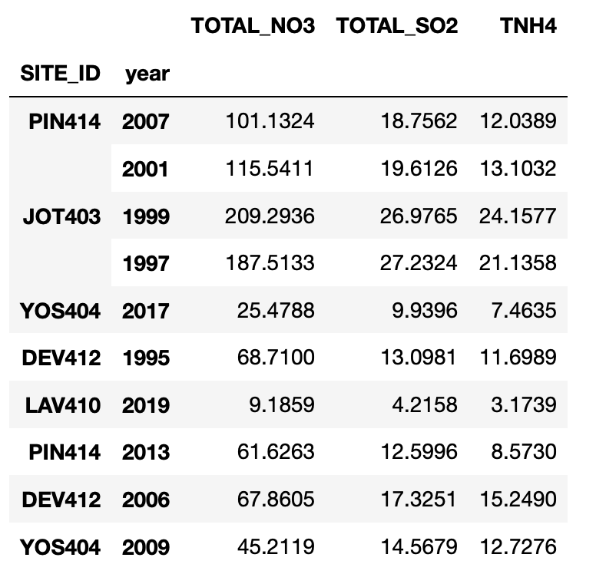
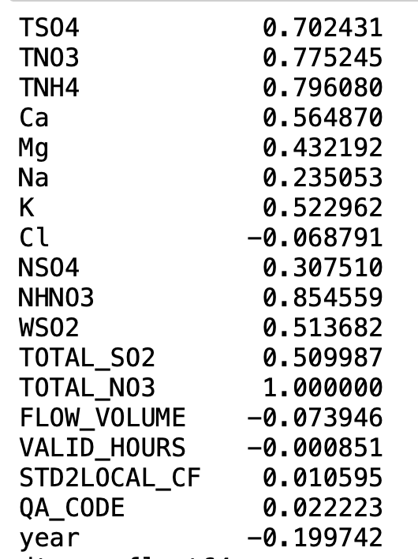
Observations
Strong correlation between concentration of other pollutants with total NO3:
TOTAL SO2
NH4
Slightly negative correlation total NO3 with years → overall decline over time
Summed the data per pollutant to study trends by site over time

Slide 3
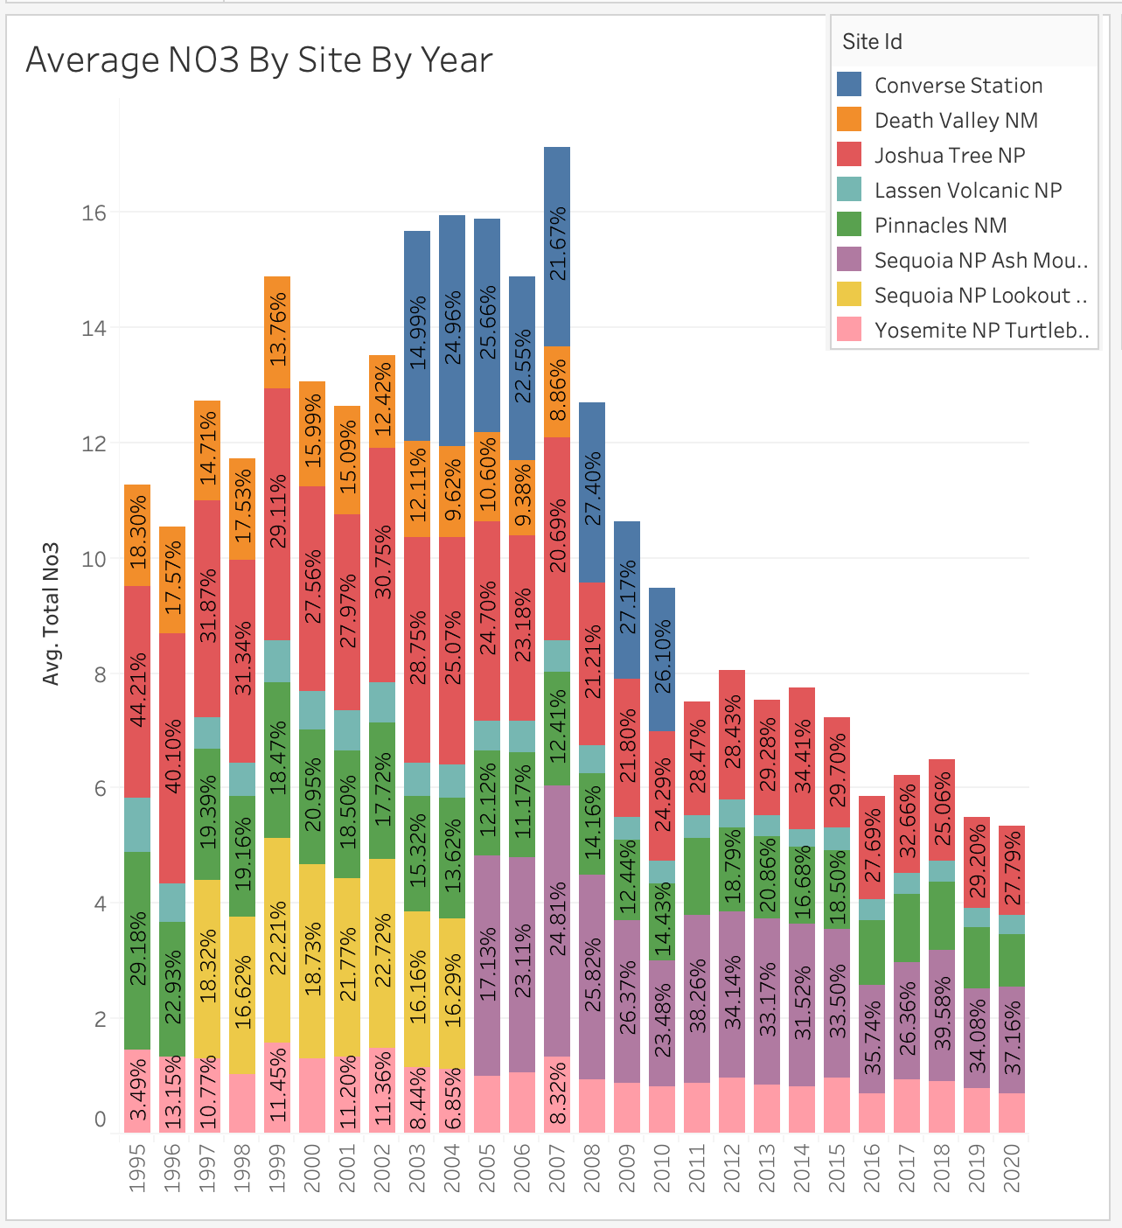
Observations:
Certain sites had missing data for Total NO3, i.e. Converse Station, Death Valley, appears that these sites stopped testing
Sequoia NP - data taken from two separate locations over time - should be viewed continuously
Beginning in 2012, each site saw a decreasing trend of NO3 resulting in Total NO3 decreasing over time to 2020

Slide 4
Predictions
Preprocessing:
Filled chemicals missing data w/median at site
Model
Feature selection: all numeric columns + one hot encoded object columns
Feature engineering: monthly and weekly time periods
Algorithms
Linear Regression: Sum of Squared Errors = 2.2e-06

